Slide 1
CDBG Best Practices – Subrecipient Monitoring
Anne Marie Belrose – City of Boston, MA
NCDA Annual Conference
June 22-24, 2022

Slide 2
HUD Monitoring: Think of it as an open-book exam that you can ace.
Ask which activities will be monitored as soon as you receive a monitoring letter.
Ask which monitoring checklist will be used (your CPD representative will tell you.)
Get the checklist from hudexchange.info
Organize the file in a manner consistent with the checklist: label and tag every document that is responsive to a question on the checklist. Remove duplicative, incomplete, or draft documents that will make the files appear disorganized.
Complete the monitoring checklist yourself in preparation for the visit. There will be no surprises and will ensure the monitoring goes smoothly.

Slide 3
Some things to keep in mind…
Periodically review your written agreements and policies and procedures. (This is particularly important in the context of the COFAR.)
Managing CDBG: A Guide For CDBG Grantees on Subrecipient Oversight (hudexchange.info) – This is a useful tool, though it has not been updated to include the COFAR references.
Some helpful hints from the OIG: Integrity Bulletin on Subrecipient Oversight and Monitoring: A Roadmap for Improved Results

Slide 4
Written agreements
Be sure to include required elements in your “subaward document”
Regulatory Reference: 2 CFR 200.331(a)
Former parlance: contracts
Your prior “contracts” or “written agreements” probably had some, most, or all of these elements. Review the regulation and the elements listed to ensure you have all of them in order to avoid a finding.

Slide 5
Written agreements Essential Elements – 2 CFR 200
Subrecipient name
Subrecipient Unique Entity Number (EIN)
Federal Award Date to Subrecipient
Period of Performance
Total federal award commitment
Total approved cost sharing
Indirect cost rate for award (or de minimis rate)

Slide 6
Written agreements Essential Elements – 2 CFR 200
Federal Award Project Description (Scope)
Federal awarding agency and official contact information
CFDA number and name
Identify whether the award is for research and development

Slide 7
Written Policies and Procedures Regulatory References for those required by Uniform Guidance
Financial Management: 2CFR 200.302
Payments: 2 CFR 200.305
General Procurement Standards: 2 CFR 200.318
Competition: 2 CFR 200.319
Methods of Procurement to be Followed: 2 CFR 200.320

Slide 8
Written Policies and Procedures Regulatory References for those required by Uniform Guidance
Compensation – Personal Services: 2 CFR 200.430
Compensation – Fringe Benefits: 2 CFR 200.431
Relocation Costs of Employees: 2 CFR 200.464
Travel Cost: 2 CFR 200.474

Slide 9
Monitoring subrecipients annually
Boston’s example:
For subrecipients subject to Audit:
Automated monthly e-mails to ensure the City receives the audit in a timely fashion
Within 30 days of auditee’s receipt of final audit
By March 31st
WHICHEVER OCCURS FIRST IN TIME
For subrecipients not subject to Audit:
Completed Good Governance Checklist by a CPA
Deficiencies identified in a letter to subrecipient
Subrecipient has 30 days to respond in writing with a corrective action plan

Slide 10
A monitoring example from Boston
Our Good Governance Checklist was developed as a result of a HUD monitoring review of our Main Streets Program a few years ago. We implemented it as part of our monitoring for all non-audited subrecipients.
An independent CPA firm completes the Good Governance Checklist, then submits it to the City.
The City reviews it, then requests a remediation plan to be completed by the subrecipient within 30 days.
The City then conducts an on-site monitoring visit to ensure implementation has occurred, and services are being provided in accordance with the agreement.

Slide 11
Good Governance General
The organization has a mission statement which is in writing and is approved by the board.
There is an accounting manual in place.
If yes, it includes: an organizational chart, job descriptions, outlining duties and responsibilities, descriptions of methods, procedures, and accounting principles to be followed, a chart of accounts and any other documents or forms for which uniformity of use is desired.
Employee responsibilities are well-defined and communicated to employees in an employee manual.
There is a policy in place and functioning to identify and monitor related party transactions as well as the board.

Slide 12
Good Governance General
There is an Information Technology policy in place.
Access to the accounting software is appropriately limited based upon the employee’s role and responsibilities.
There are written disaster recovery procedures in place in case of emergency.
The Organization has a donated services/items policy.
Depending on size of organization and/or requirements set in the organizations by-laws, they receive the required annual audit, review or compilation of their financial statements.
The Organization is operating within a budget.

Slide 13
Good Governance Organizational Governance
The Organization has an active Board which meets regularly or as required in their by-laws.
The required number of Board members as set in the by-laws is maintained.
Minutes of the Board and Committee meetings are maintained.
The Organization has a finance or audit committee to oversee financial reporting and tax reporting.
The Board receives financial statements (balance sheet and activities) for review at each meeting.

Slide 14
Good Governance Organizational Governance
The Organization has a conflict of interest policy.
All officers/directors are required to annually disclose potential conflicts of interest.
The Organization has a whistleblower policy.
The Organization has a related party policy.
The Organization has a record retention policy.

Slide 15
Good Governance Cash Management
Bank statements are opened by the Executive Director, or an individual not responsible for bookkeeping.
Bank statements include copies of cancelled checks for review.
Executive Director documents their review of the bank statement.
Monthly bank reconciliations are performed.
The reconciliation is reviewed by an individual not responsible for other cash functions and the review is properly documented.
Outstanding checks are periodically reviewed for stale items.

Slide 16
Good Governance Cash Management
If stale checks are identified the proper procedures are performed to clear the transaction.
Special cash accounts are maintained as required by contracts, all other cash is maintained in the general operating or savings accounts.
Checks are endorsed immediately when received.
A list of all receipts is documented as they are opened.
Receipts are processed timely as defined by each organization depending on level of activity.

Slide 17
Good Governance Cash Management
Deposit slips are matched against the list of receipts for completeness.
There is adequate segregation of duties over cash receipts.
Blank checks do not get signed in advance due to check signor absence.
The use of a signature stamp is not used.
All checks are written in sequential order.

Slide 18
Good Governance Cash Management
If a check needs to be voided the proper defacement of the check and removal of the signature portion is performed.
The practice of writing checks payable to ‘cash’ is rarely used, preferably not at all.
Original supporting documentation for all cash disbursements is maintained.

Slide 19
Good Governance Cash Management
Check signatories review all supporting documentation prior to signing the check.
Once invoices are paid there is proper documentation on the physical invoice such as a “paid” stamp or initials of the individual signing the check to prevent duplicate disbursements.
The Organization has a policy which requires dual signatures for all checks over a threshold amount determined by the Board.

Slide 20
Good Governance Cash Management
The dual signature policy is consistently followed.
The number of authorized check signatories within the Organization is reasonable. Typically two or three depending on the size of the organization.
Former employees with signatory authority are promptly removed from the bank accounts upon departure.
Debit cards are not used by the Organization.
There is a policy in place which requires management’s approval of payment to higher interest vendors or those who charge late fees.
On-line banking access is restricted to those requiring access. When possible authorization should be restricted to only those functions within their roles.

Slide 21
Good Governance Investments
The Organization has a formal written investment policy which includes the Board’s philosophies, policies and goals.
Investments are reconciled to the monthly statements in addition to a quarterly report on the return on investment for use by the Board.

Slide 22
Good Governance Accounts Receivable/Revenue
There are monthly reconciliations of the accounts receivable aging report to the general ledger.
The accounts receivable aging report is periodically reviewed for old balances by management.
There is a policy in place which evaluates older balances for collectability and an allowance for doubtful accounts is maintained.
Once accounts are identified as uncollectible they are properly written off and removed from the books.

Slide 23
Good Governance Accounts Receivable/Revenue
The Organization has a revenue recognition policy in place.
Controls are in place which ensures revenue is recorded in the proper period.
Pledges and contribution receivables are properly recorded and restricted, if applicable.

Slide 24
Good Governance Grants
If grants or contracts are received, there are procedures in place to ensure compliance requirements are met.
Supporting documentation is maintained for all grant expenses under grant agreement.
Procedures are in place to ensure timely invoicing of grant expenditures.
Required report submissions are made to grantor agencies.

Slide 25
Good Governance Fixed Assets
The Organization has an approved capitalization policy. The threshold is set based on the level of activity and nature of the program.
The capitalization policy includes the useful lives of assets which are to be used for depreciation purposes.
Fixed asset records are maintained which lists the description of the asset, cost, date placed in service, estimated useful life, depreciation method, depreciation expense and accumulated depreciation for the year.
If applicable, a physical inventory of fixed assets is performed.
The fixed asset listing is periodically reviewed for out of service or retired assets to be written off.
All major fixed asset purchases receive prior written approval by a responsible key employee.

Slide 26
Good Governance Accounts Payable/Expenses
A policy is in place which requires supporting documentation for all charges to a corporate credit card and also prohibits the personal use of the corporate card.
Former employees with a corporate credit card are promptly removed from the account upon departure.
There are monthly reconciliations of the accounts payable aging report to the general ledger.
All invoices received are entered into the accounting system as an accounts payable upon receipt.

Slide 27
Good Governance Accounts Payable/Expenses
The Organization has a policy in place which ensures proper cutoff of expenses.
A policy is in place which requires supporting documentation for all charges to a corporate credit card and also prohibits the personal use of the corporate card.
Former employees with a corporate credit card are promptly removed from the account upon departure.

Slide 28
Good Governance Accounts Payable/Expenses
There are monthly reconciliations of the accounts payable aging report to the general ledger.
All invoices received are entered into the accounting system as an accounts payable upon receipt.
The Organization has a policy in place which ensures proper cutoff of expenses.
If applicable, all debt covenants are monitored and met.

Slide 29
Good Governance Payroll
Management reviews the payroll report prepared and processed for each payroll period. This review is documented each pay period and copies of the reports are maintained.
The addition of a new employee to the payroll is approved by management.
Personnel files are maintained and updated periodically including annual reviews and authorized pay rate changes.
The Organization has an employee manual which is distributed and reviewed with each employee upon hire.

Slide 30
Good Governance Payroll
The Organization has an approved vacation policy in place which is consistently followed.
The vacation policy includes a limit on the amount of vacation time that an employee can accumulate.
A consistent method of employee expense reimbursement is used; ideally, there is a standard form in place to document the request.
Bonuses awarded to employees are issued through the payroll system and include all the proper taxes.

Slide 31
Good Governance Payroll
Executive compensation is approved in writing by the Board.
If timesheets are maintained they include the proper approvals by the employee’s immediate supervisor.
All required payroll tax filings are been completed and submitted in a timely fashion.
W-2’s and 1099’s are issued as needed.

Slide 32
Good Governance Taxes
If the Organization has received tax exemption, invoices are reviewed to ensure sales tax is not being charged.
If charitable contributions are received from individuals, a letter indicating their contribution is tax-exempt is sent to the donor if it exceeds $250.
All required tax filings have been filed timely, specifically the Form 990 and MA PC.
The Organization has reviewed all activities for potential unrelated business income.
If unrelated business income is identified, related income and expenses are documented separately from program transactions. The required tax filings are processed timely.

Slide 33
Good Governance Insurance
The Organization has a policy in place to analyze potential risk and coverage for:
Workers Compensation
Property Insurance
Casualty Insurance
Director Liability Insurance
Errors and Omissions Insurance
Organization Liability Insurance

Slide 34
Good Governance Financial statements
The Organization must provide copies of annual financial statements to the City.

Slide 35
Good Governance Checklist
If you’d like an editable version of the checklist, just ask: annemarie.belrose@boston.gov

Slide 36
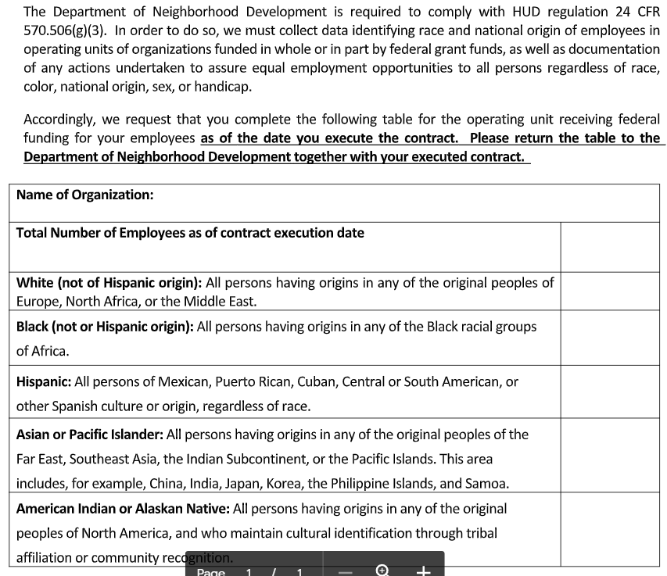
EEO-4 Compliance

Slide 37
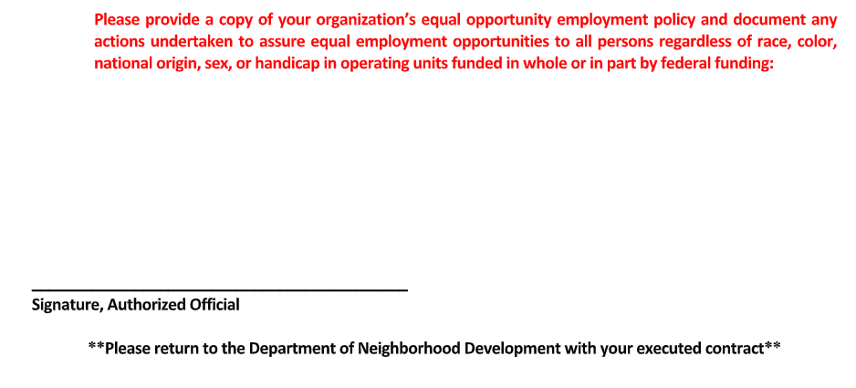
EEO-4 Compliance – continued

Slide 38
Findings you can avoid
Failure to monitor subrecipients
Or, failure to document monitoring
Or, failure to follow-up on deficiencies identified during monitoring
EEO-4 Compliance
Subaward documents did not include information required by the regulation
Inadequate or untimely reporting (Section 3, Davis-Bacon, MWBE)
National Objective/Activity & Beneficiary Eligibility Documentation
Required tests: HQS Inspections (and other housing inspections)
OIG review of HUD’s programs!

Slide 39
Questions?

